Slide 1
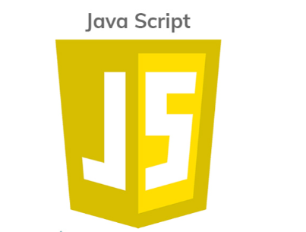
JavaScript, abbreviated as ‘JS’ is a programming language that is one of the core technologies of the World Wide Web, alongside HTML and CSS. It can calculate, manipulate and validate data.
It is a scripting language used to create and control dynamic website content like animated graphics, photo slideshows, content updates, animated 2D/3D graphics, scrolling video jukeboxes etc.

Slide 2
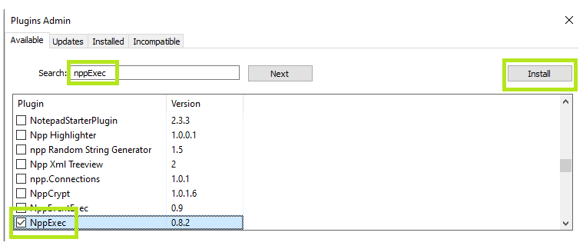
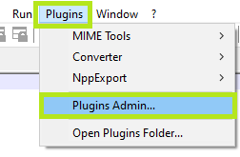
Installation
Install node.js
Install notepad++ https://notepad-plus-plus.org/
Install nppExec

Slide 3
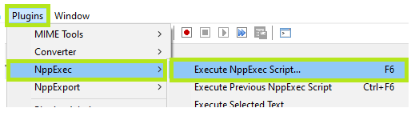
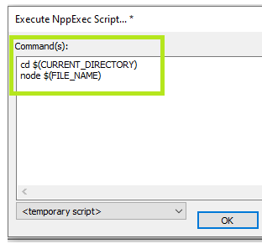
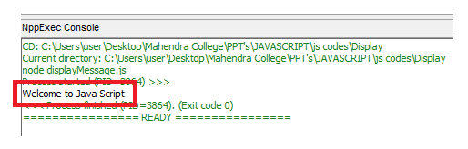
Running <‘js’> code through notepad++

Slide 4
Display Possibilities
Writing into an HTML element, using innerHTML.
Writing into the HTML output, using document.write().
Writing into an alert box, using window.alert().
Writing into the browser console, using console.log().

Slide 5
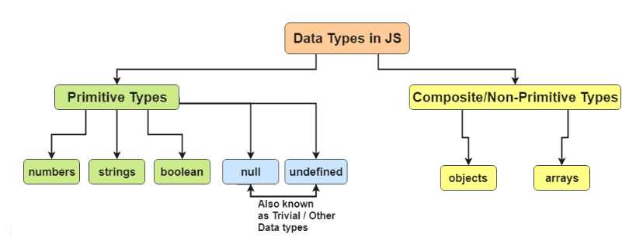
JavaScript Data Types

Slide 6
Variables are Containers for Storing Data
Variables can be declared in 4 ways:
Automatically
Using var Keyword was used in all JavaScript code from 1995 to 2015. Use if old browser has to be supported.
Using let Keyword added to JavaScript in 2015. Use if const can't be used.
Using const Keyword added to JavaScript in 2015. Use if the value / type should not be changed (Arrays and Objects).
Difference between var and let. Variable declared by let cannot be redeclared and must be declared before use.

Slide 7
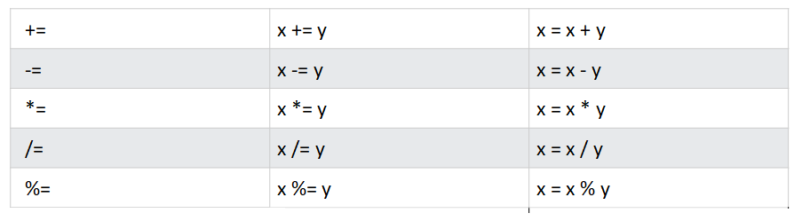
Operator
Typeof –
In JavaScript is an operator used for type checking and returns the data type of the operand passed to it. The operand can be any variable, function, or object.
Assignment Operator - ( = ) to assign values to variables.
.

Slide 8
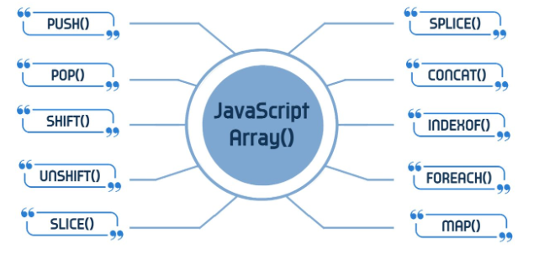
Array Methods

Slide 9
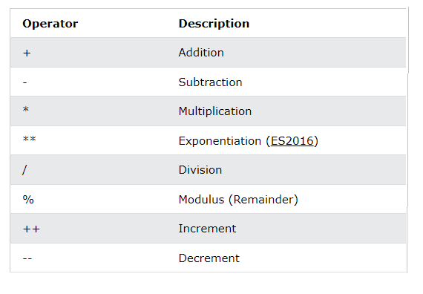
Arithmetic Operators -

Slide 10
Syntax
Single Line Comments - Start with //.
Multi-line Comments - Start with /* and end with */.
Hyphens are not allowed in JavaScript. Ex: var first_Name
Use camel case that starts with a lowercase letter. Ex: var firstName

Slide 11
Function Syntax - Is defined with the function keyword, followed by a name, and parentheses (). The parentheses may include the parameter names separated by commas (parameter1, parameter2, ...).
function name(parameter1, parameter2) { //Code to be executed }
//When Function is called, the return value will be stored in x. let x = functionName(4, 3); function functionName(a, b) { return a * b; // Function returns the product of a and b }

Slide 12
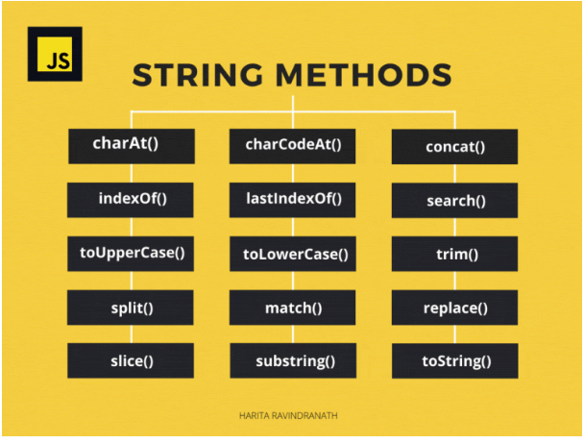
String Methods

